Slide 1

Breadth-First Search
Systematic Problem Solving

Slide 2


Et Tu Brute?
Breadth-first search is a brute-force approach that explores sibling nodes before children.
A
B
Queue
I
D
I
A
C
B
E
D
F
C
F
E
SOLUTION:
I
A
B
D
The main difference between a breadth-first traversal and search is the goal check.

Slide 3
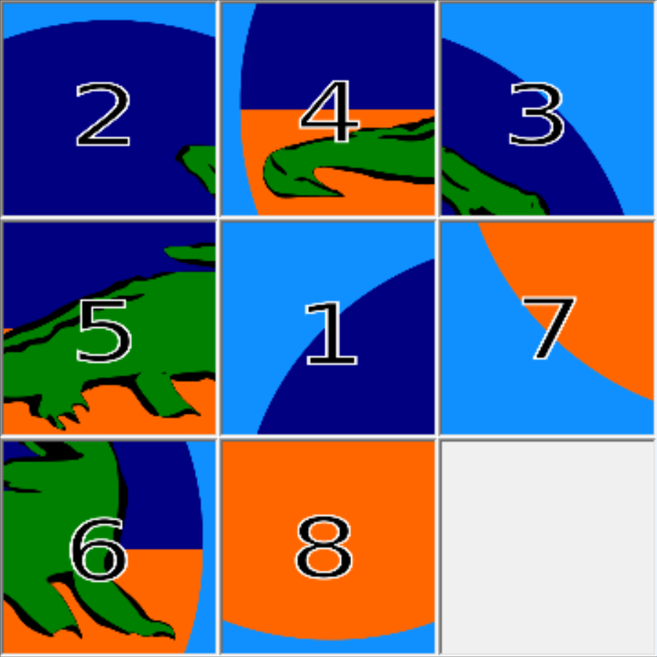
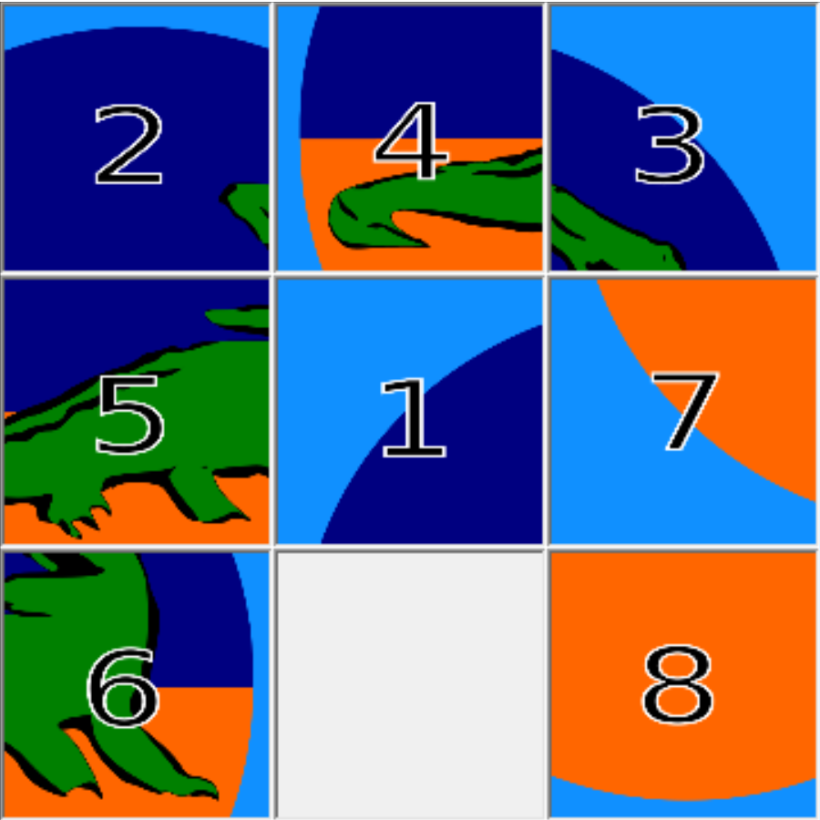
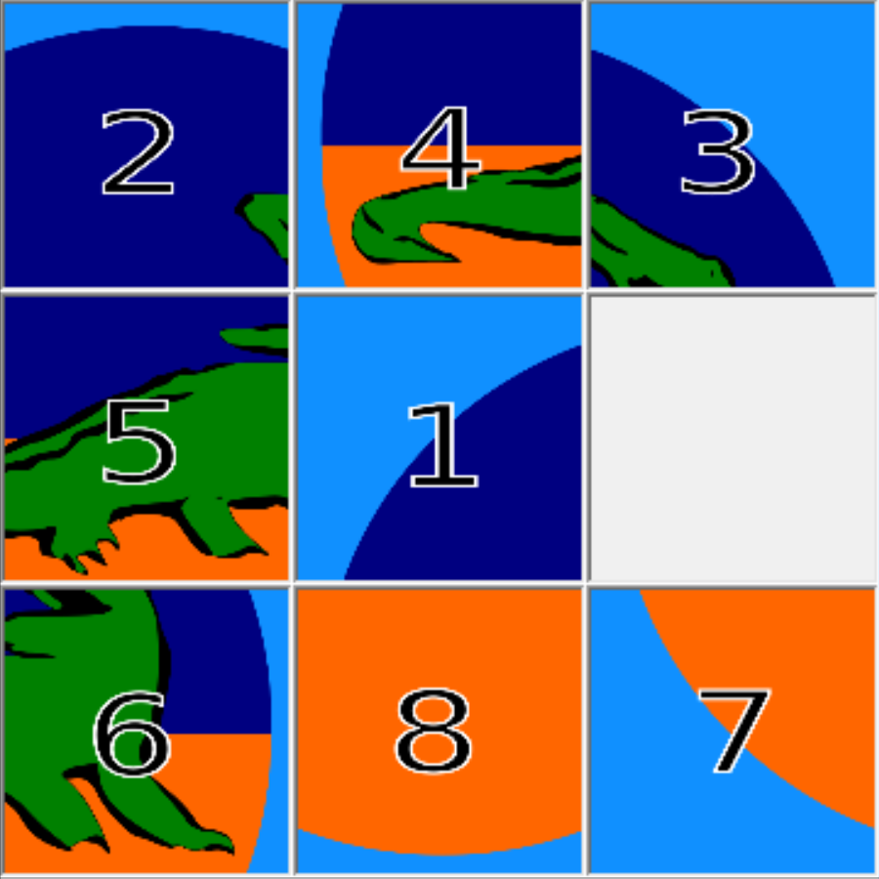
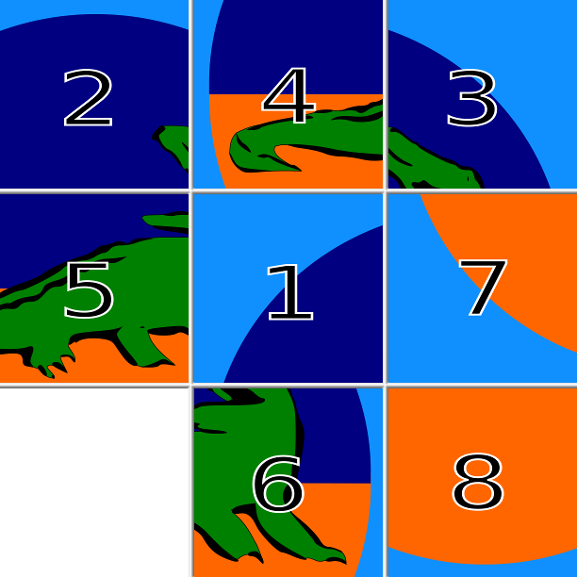
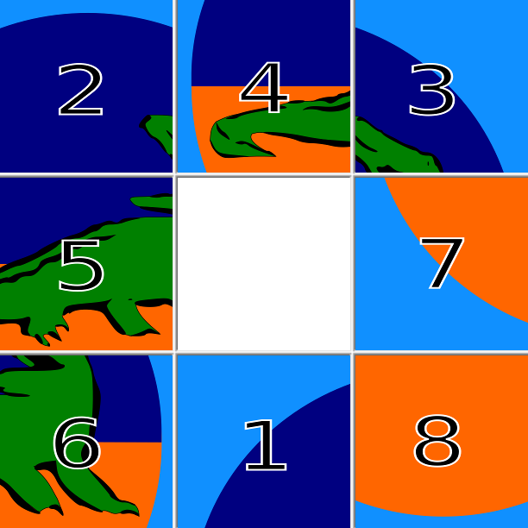
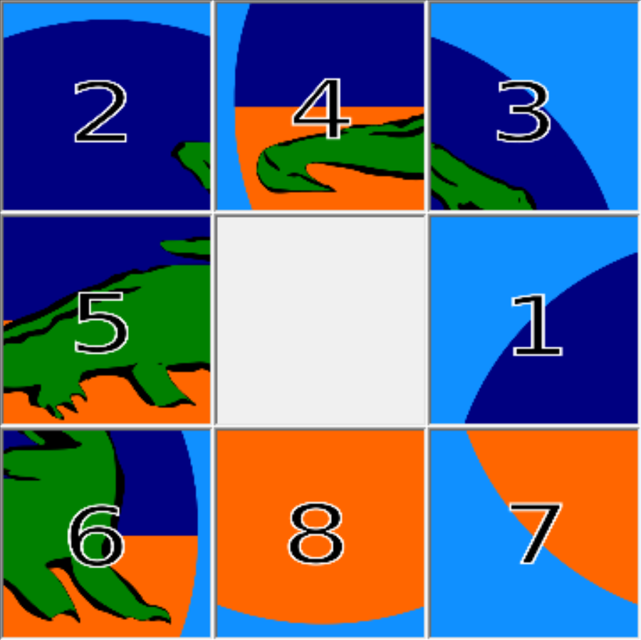
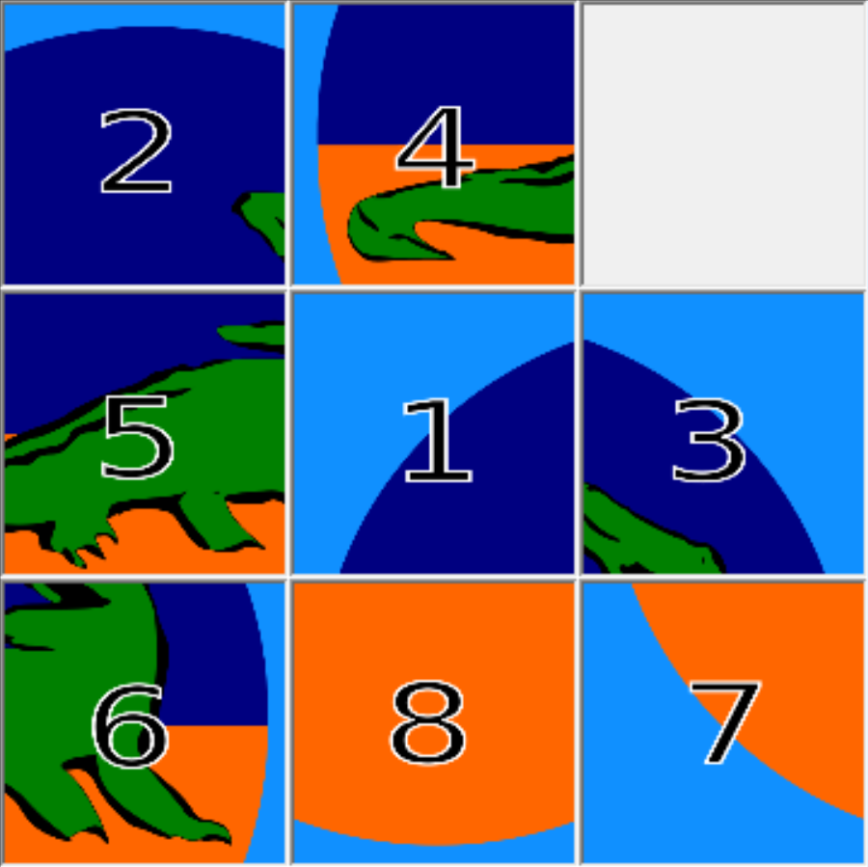
Breadth-First: The 8-Puzzle
Example:

Slide 4





Breadth-First Search
Breadth-First Search is:
Systematic (Processes in order)
Uninformed (no prior knowledge)
Optimal in steps (Any solution found is “best”)
Complete (Will find a solution if it exists)
Exhaustive (Finds a solution if state space is finite)
Optimal
Complete
Exhaustive

Slide 5
Breadth-First Search: Static Graphs
class Vertex:
def __init__(d):
self.data = d
self.edges = []
class Edge:
def __init__(e, c):
self.endpoint = e
self.cost = c
class PlannerNode:
def __init__(self, v, p):
self.vertex = v
self.parent = p
Remember: we need to trace backwards at the end!
def breadthFirstSearch(start, goal):
open = list()
open.enqueue(PlannerNode(start, None))
visited = { start: open[0] }
while not len(open) is 0:
current = open.dequeue()
if current.vertex is goal:
return build_solution(start, current)
for edge in current.vertex.edges:
successor = edge.endpoint
if not visited[successor]:
newNode = PlannerNode(successor, current)
visited[successor] = newNode
open.enqueue(newNode)

Slide 6

Breadth-First Search: Dynamic
def breadthFirstSearch(start, goal):
open = list()
visited = { start: PlannerNode(start, None) }
open.append(visited[start])
while not len(open) is 0:
current = open.pop(0)
if current.state is goal:
return build_solution(start, current)
for operator in get_valid_ops(current.state):
successor = current.state.apply(operator)
if not visited[successor]:
newNode = PlannerNode(successor, current)
visited[successor] = newNode
open.append(newNode)
return None
Successor generation is…
Problem-specific
Usually non-trivial in time
Sometimes inefficient
Search graphs are superior when practical.

Slide 7
Problems with Breadth-First Search
While breadth-first search is effective, it has problems:
Lots of memory and lots of time
Optimal in terms of steps (not necessarily cost)
A
B
I
D
C
We can expand via a best-first search - one that processes elements according to some evaluation - with the “best” coming first, usually via priority queue.

Slide 8
Fin

